Slide 1
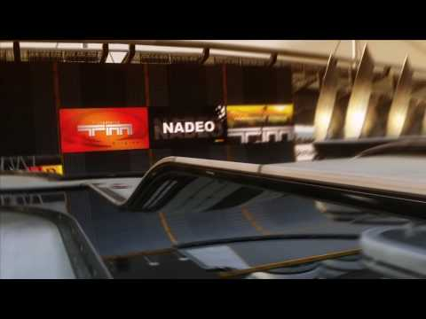
TMCHALLENGER
By:
Kamal Nimmagadda
Mehul Kohli
Ritika Singhal
Rohan Marathe

Slide 2
Project Description
Creating a racing agent for the game of TrackMania
Training the model to find the best path to complete the speedrun for any given map

Slide 3
Project Video
https://www.youtube.com/watch?v=U8qLp2YcmC0&feature=youtu.be

Slide 4
Networks Used in this Project
In this project, a total of 3 networks are used:
CNN for Digit Recognition on speed and timestamps from the game frame
CNN for collision detection while car moves in the game frame
Double DQN model: the main model to make the car learn
We will discuss about DQN model in
detail...

Slide 5
DQN Model
Double DQN Approach: Use of a separate target model to fix Q-targets while training.
States: A queue of 6 frames in real time from the gameplay, speed list and timestamp list in the 6 frames.
Input Shape (6 frames): 6 x 60 x 80
Actions: 7 possible actions
Replay Memory: For random sampling of initial states fed into the model
Reward… (next slide)

Slide 6
Reward Function
Positive Reward for Speed (action other than reverse):
R(speed) = e^(6th speed value/100)
Negative Reward for Speed (action = reverse ):
R(speed) = log(abs(5th speed value - 6th speed value))
If abs(5th speed value - 6th speed value) is 0 or 1: R(speed) = -0.5
Positive Reward for completing the race: +50
Negative reward for collision: -5
Negative Reward for getting stuck on the track = -25
Cumulative Reward = Sum of all the above 5 rewards.

Slide 7
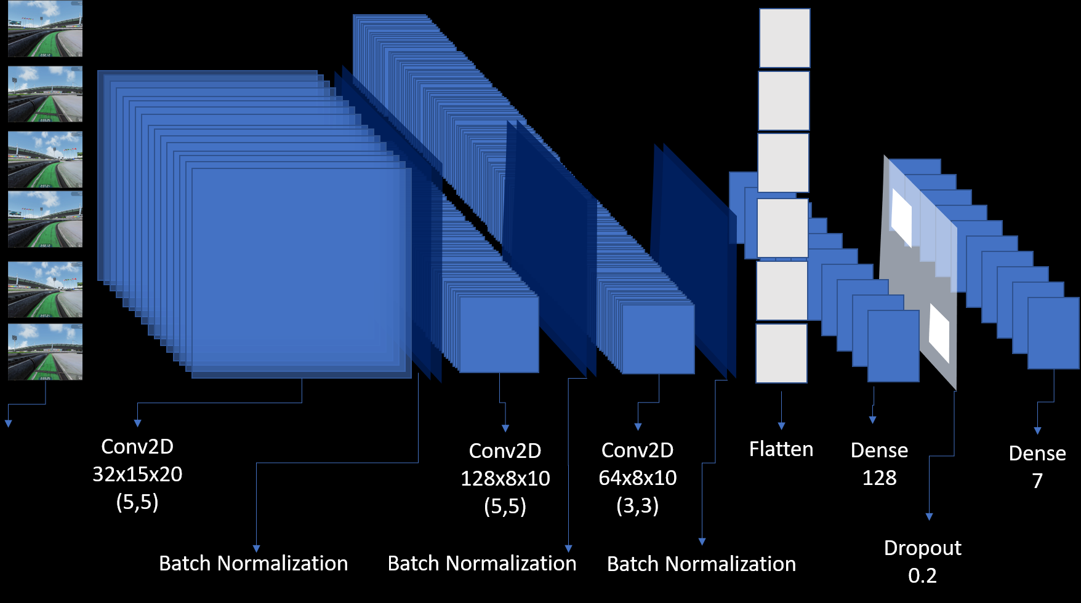
Model Architecture

Slide 8
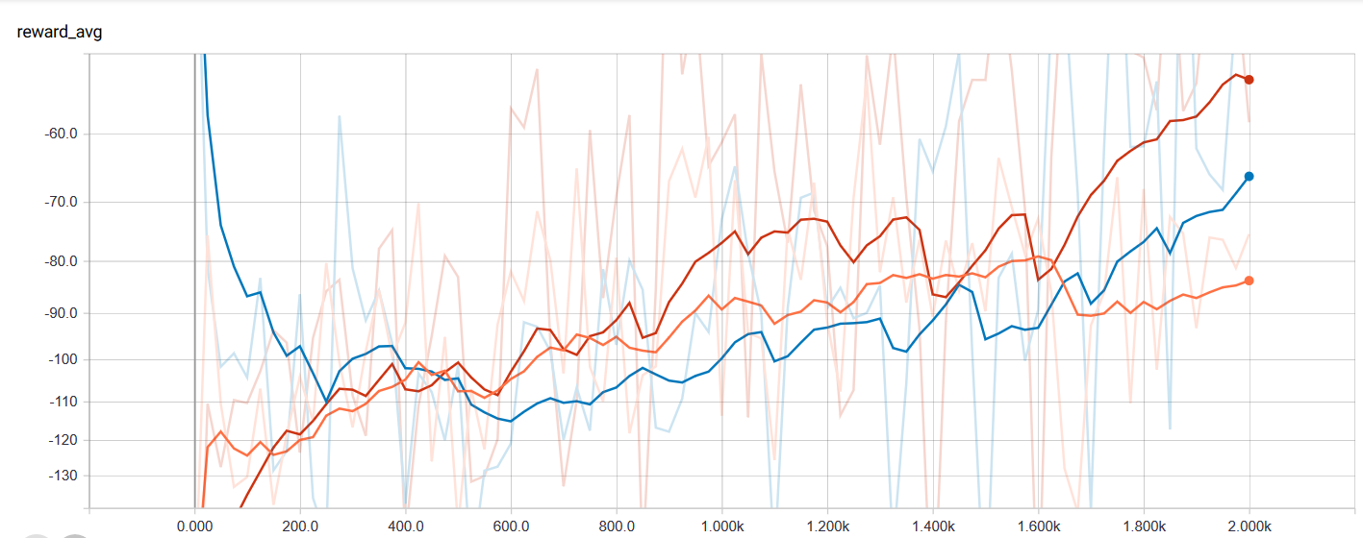
Results: Average Reward Graph
In each run, significant improvement in reward accumulation was observed

Slide 9
Challenges and Future Work
Challenges:
Training on local machine
Hyperparameter Tuning
Model Stability
Modeling the reward function
Future Work
Perfecting the model for any kind of track
Working on the minimizing the time taken to complete the race

Slide 10
THANK YOU

